Slide 1
A brief tutorial on combinational logic and finite state machine

Slide 2
Combinational elements
The function of a combinational element is specified by its truth table
The truth table enumerates all the different combinations of its input and specifies the corresponding output
The truth tables for AND gate, OR gate and Negation
Ungraded homework:
How many rows is there for a 4 input truth table?
How many functions can a 2 input combinational element implement?

Slide 3
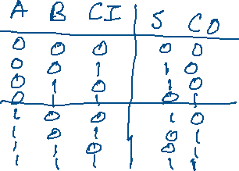
Combinational circuit
A combinational circuit (element) is composed by a number of combinational elements.
The truth table of an one digit adder
Ungraded homework:
Any combinational circuit can be implemented by AND, OR and Negation only (the three elements are called functionally complete)
Specify the truth table of an one digit subtractor
How can you use parallel processing and pipelining to speed up an 16 digit adder?

Slide 4
Finite state machine
A finite state machine consists of
A set of states
A set of events
A set of state transitions
{operations in a state}
The door example
What if the door can be locked?
Can you recreate the FSM described in the class?

Slide 5
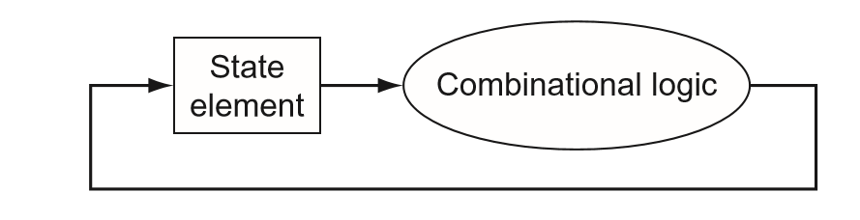
Finite state machine and combinational circuit
What if the door is locked and requires guard action?

